Slide 1
Operating System 1
Dr. Faris Llwaah
University of Mosul
College of Computer Sciences and Mathematics
Department of Computing Sciences

Slide 2
Introduction

Slide 3
Why should we study operating systems?
Need to understand interaction between the hardware and applications.
* To keep pace with new applications, new hardware…….
* To learn about system design so that we can extend the features of operating system.
* To solve any problem occurring in operating system.
* To learn how to manage the computer resources appropriately.
Need to understand basic principles in the design of computer systems.
* To obtain an efficient resource management, security, flexibility
Increasing need for specialized operating systems.
* For example embedded operating systems for devices – cell phones, sensors and
controllers.
* real-time operating systems - aircraft control, multimedia services
Notes:
لماذا يجب ان ندرس انظمة التسغيل
1 – نحتاج الى فهم التفاعل بين الاجهزة والتطبيقات
- لمواكبة التطبيقات والاجهزة الجديدة
- لمعرفة المزيد عن تصميم النظام ختى نتمكن من توسيع ميزات نظام التشغيل
- لحل اي مسكلة تحدث في نظام التشغيل
- لمعرفة كيفية ادارة الموارد للحاسوب بشكل مناسب
2- الحاجة الى فهم المبادؤ الاساسية في تصميم نظم الحاسوب
- للحصول على كفاءة في ادارة الموارد, الامن, المرونة
3- ازدياد الحاجة لانظمة حاسوب متخصص
- على سبيل المثال انظمة التشغيل المضمنة للاجهزة
- الهواتف المحمولة واجهزة الاستشعار واجهزة التحكم
- ايضا انظمة التشغيل للوقت الحقيقي مثل التحكم بالطائرات, وخدمات الوسائط المتعددة

Slide 4
What is an operating system?
Notes:
ماهو نظام التشغيل

Slide 5
An Operating System (OS) is an interface between a computer user and computer hardware. An operating system is a software which performs all the basic tasks like file management, memory management, processor management, handling input and output, and controlling peripheral devices such as disk drives and printers.
An operating system is a program that acts as an interface between the user and the computer hardware and controls the execution of all kinds of programs.
Notes:
- نظام التشغيل هو عبارة عن وسيط بين المستخدم واجهزة الحاسوب, حيث يعتبر نظام التشغيل برنامج يقوم بجميع المهام الاساسية مثل ادارة الملفات, ادارة الذاكرة, ادارة المعالج الذي يقوم بعمليات الحاسب والمنطق, الادخال والاخراج والتحكم في الاجهزة الطرفية مثل محرك الافراص والطابعات
. - نظام التشغيل هو برنامج يعمل كوسيط بين المستخدم واجهزة الحاسوب ويتحكم في تشغيل جميع انواع البرامج

Slide 7
OS FUNCTIONS
The main functions of operating systems are:
Manages and Interacts with Computer Hardware
Process the tasks
Provides the User/ Computer Interface (CLI / GUI)
Provides the Interface for Application Software
Input / Output Operations
Error Detection, Resource Allocation, Security and
Protection
Notes:
الوظائف الرئيسية لنظام التشغيل
- يدير ويتفاعل مع اجهزة الحاسوب
- معالجة المهام
- يوفر واجهة المستخدم مع الحاسوب
- يوفر التفاعل مع البرنامج التطبقي
- كشف الاخطاء, تخصيص الموارد, الامن
- الحماية

Slide 8
Two types of interfaces

Slide 9
Operating Systems – Types
Operating systems are there from the very first computer generation and they keep
evolving with time. In this section, I would discuss some of the important types of
operating systems that are most commonly used.
Batch Operating System
The users of a batch operating system do not interact with the computer directly. Each user
prepares his job on an off-line device like “punch cards” and submits it to the
computer operator. To speed up processing, jobs with similar needs are batched
together and run as a group. The programmers leave their programs with the
operator and the operator then sorts the programs with similar requirements into
batches.
Notes:
- مستخدمو نظام التشغيل الحزمــــة لايتفاعلون مع الحاسوب مباشرتا, حيث يقوم كل مستخدم باعداد وظيفة على جهاز مفصول مثال ذلك مثقب البطاقات وارسالها الى مشغل الحاسوب ( موظف). لتسرسع المعالجة يقوم مشغل الحاسوب بتجمبع المهام ذات الاحتياجات المتماثلة معا وتشغيلها كمجموجة. جميع برامج فورتران تجمع لتسغيل مترجم فورتران مرة واحدة. حيث المبرمجون يتركون برامجهم مع عامل التسغيل والمشغل هو يفوم بفرز البرامج ذات المتطلبات المتماثلة في دفعات.

Slide 10
The problems with Batch Systems are as follows:
Lack of interaction between the user and the job.
CPU is often idle, because the speed of the mechanical I/O devices is slower than the CPU.
Difficult to provide the desired priority.
Notes:
من مساوى هذه الطريقة
- عدم وجود تفاعل بين المستخدم والوظيفة
- غالبا ماتكون وحدة المعالج المركزي خاملة في بعض الاوفات ولايمكن الحصول على الاستفادة القصوى منها والسبب هو بطئ سرعة اجهزة الادخال والاخراج بالقياس مع وحدة المعالجة المركزية.
- صعوبة في توفير الاولوية المطلوبة
-

Slide 11
Time-sharing Operating Systems
Time-sharing is a technique which enables many people, located at various terminals, to use a particular computer system at the same time. Time-sharing or multitasking is a logical extension of multiprogramming. Processor's time which is shared among multiple users simultaneously is termed as time-sharing.
The main difference between Multi-programmed Batch Systems and Time-Sharing Systems is that in case of Multi-programmed batch systems, the objective is to maximize processor use, whereas in Time-Sharing Systems, the objective is to minimize response time.
Multiple jobs are executed by the CPU by switching between them, but the switches occur so frequently. Thus, the user can receive an immediate response. For example, in a transaction processing, the processor executes each user program in a short burst or quantum of computation. That is, if N users are present, then each user can get a time quantum. When the user submits the command, the response time is in few seconds at most.
Notes:
انظمة التشغيل تتقاسم الوقت
- المشاركة الزمنية وهي التقنية التي يمكن للعديد من الاشخاص الموجودين في طرفيات مختلفة من استخدام نظام حاسوب معين في نفس الوقت. حيث يعد تقاسم
الوقت او تعدد المهام امتدادا للبرمجة المنطقية. ويسمى وقت المعالج الذي يتم مشاركته بين عدة مستخدمين في نفس الوقت بانه مشاركة الوقت.
وانظمة مساركة الوقت. الاول لزيادة استخدام المعالج الى اقصى حد, بينما يكون الهدف من الثاني Multi-programmed Batch- الاختلاف الرئيسي بين انظمة
تقليل وقت الاستجابة
يتم تنفيذ المهام المتعددة بواسطة وحدة معالجة مركزية واحدة عن طريق تحويل المعالج بينهم وهذه تحدث بشكل متكرر وبالتالي يحصل المستخدم على ااستجابة فورية
من المستخدينNعلى سبيل المثال في معالجة المعاملات ينفذ المعالج كل برنامج مستخدم في دفعة قصيرة او كم من الحسابات. اي اذا كان هنالك
فيمكن لكل مستخدم الحصول على وقت محدد عندما يرسل المستخدم الامر وبهذا يكون وقت الاستجابة في بضع ثوان على الاكثر

Slide 12
The operating system uses CPU scheduling and multiprogramming to provide each user with a small portion of a time. Computer systems that were designed primarily as batch systems have been modified to time-sharing systems.

Slide 13
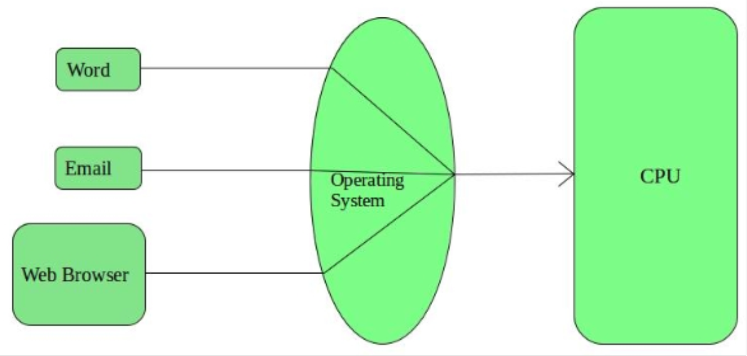
Advantages of Timesharing operating systems are as follows:
Provides the advantage of quick response
Avoids duplication of software
Reduces CPU idle time
Disadvantages of Time-sharing operating systems are as follows:
Problem of reliability
Question of security and integrity of user programs and data
Problem of data communication

Slide 14
Distributed Operating System
Distributed systems use multiple central processors to serve multiple real-time applications and multiple users. Data processing jobs are distributed among the processors accordingly.
The processors communicate with one another through various communication lines (such as high-speed buses or telephone lines). These are referred as loosely coupled systems or distributed systems. Processors in a distributed system may vary in size and function. These processors are referred as sites, nodes, computers, and so on.

Slide 15
The advantages of distributed systems are as follows:
With resource sharing facility, a user at one site may be able to use the resources available at another.
Speedup the exchange of data with one another via electronic mail.
If one site fails in a distributed system, the remaining sites can potentially continue operating.
Better service to the customers.
Reduction of the load on the host computer.
Reduction of delays in data processing.
Disadvantages of Distributed Operating System:
Failure of the main network will stop the entire communication
To establish distributed systems the language which are used are not well defined yet
These types of systems are not readily available as they are very expensive. Not only that the underlying software is highly complex and not understood well yet

Slide 16
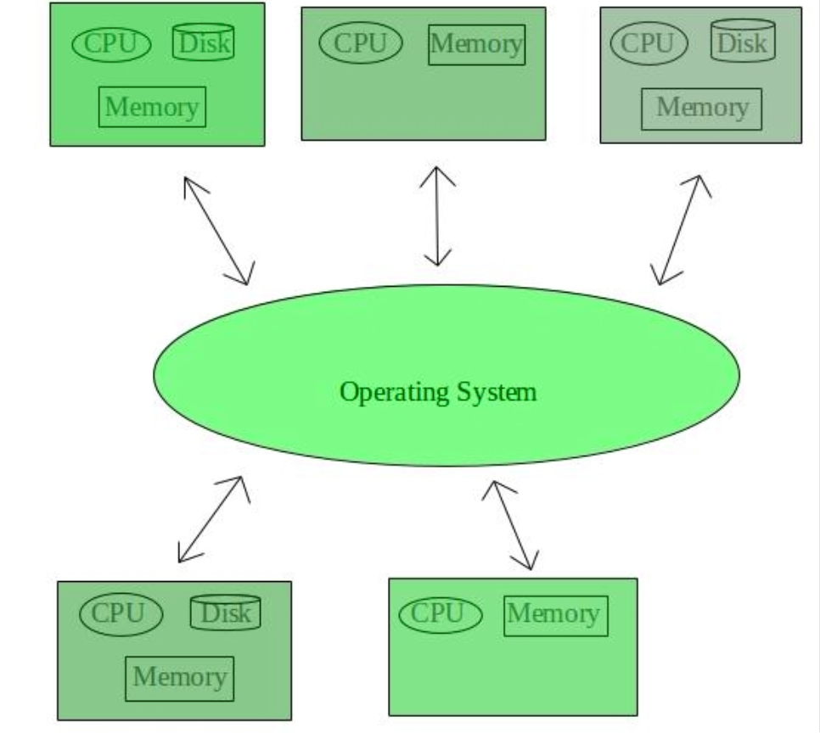

Slide 17
Network Operating System
A Network Operating System runs on a server and provides the server the capability to manage data, users, groups, security, applications, and other networking functions. The primary purpose of the network operating system is to allow shared file and printer access among multiple computers in a network, typically a local area network (LAN), a private network or to other networks.
For examples of network operating systems include Microsoft Windows Server 2003, Microsoft Windows Server 2008, UNIX, Linux, Mac OS X, Novell NetWare, and BSD.

Slide 18
Advantages of Network Operating System:
Highly stable centralized servers
Security concerns are handled through servers
New technologies and hardware up-gradation are easily integrated to the system
Server access are possible remotely from different locations and types of systems
Disadvantages of Network Operating System:
Servers are costly
User has to depend on central location for most operations
Maintenance and updates are required regularly

Slide 19
Real-Time Operating System
A real-time system is defined as a data processing system in which the time interval required to process and respond to inputs is so small that it controls the environment. The time taken by the system to respond to an input and display of required updated information is termed as the response time. So in this method, the response time is very less as compared to online processing.
Real-time systems are used when there are rigid time requirements on the operation of a processor or the flow of data and real-time systems can be used as a control device in a dedicated application. A real-time operating system must have well-defined, fixed time constraints, otherwise the system will fail. For example, Scientific experiments, medical imaging systems, industrial control systems, weapon systems, robots, air traffic control systems, etc.
There are two types of real-time operating systems.

Slide 20
Hard Real-Time Systems:
These OSs are meant for the applications where time constraints are very strict and even the shortest possible delay is not acceptable. These systems are built for saving life like automatic parachutes or air bags which are required to be readily available in case of any accident. Virtual memory is almost never found in these systems.
Soft real-time systems:
Soft real-time systems are less restrictive. A critical real-time task gets priority over other tasks and retains the priority until it completes. Soft real-time systems have limited utility than hard real-time systems. For example, multimedia, virtual reality, Advanced Scientific Projects like undersea exploration and planetary rovers, etc.

Slide 21
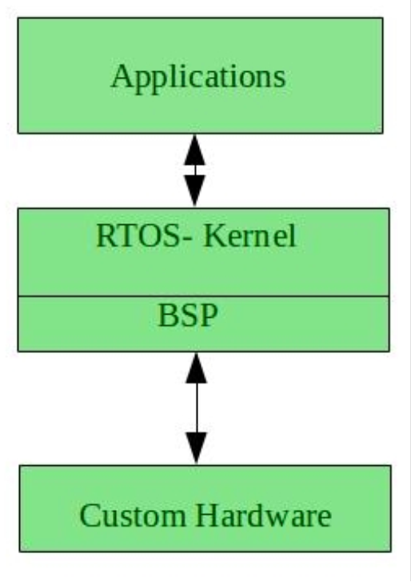
Advantages of RTOS:
Maximum Consumption: Maximum utilization of devices and system, thus more output from all the resources
Task Shifting: Time assigned for shifting tasks in these systems are very less. For example in older systems it takes about 10 micro seconds in shifting one task to another and in latest systems it takes 3 micro seconds.
Focus on Application: Focus on running applications and less importance to applications which are in queue.
Real time operating system in embedded system: Since size of programs are small, RTOS can also be used in embedded systems like in transport and others.
Error Free: These types of systems are error free.
Memory Allocation: Memory allocation is best managed in these type of systems.

Slide 22
Disadvantages of RTOS:
Limited Tasks: Very few tasks run at the same time and their concentration is very less on few applications to avoid errors.
Use heavy system resources: Sometimes the system resources are not so good and they are expensive as well.
Complex Algorithms: The algorithms are very complex and difficult for the designer to write on.
Device driver and interrupt signals: It needs specific device drivers and interrupt signals to response earliest to interrupts.
Thread Priority: It is not good to set thread priority as these systems are very less prone to switching tasks.
Examples of Real-Time Operating Systems are: Scientific experiments, medical imaging systems, industrial control systems, weapon systems, robots, air traffic control systems, etc.

Slide 23
Computer System Structure

Slide 24
COMPUTER SYSTEM STRUCTURE
Computer system can be divided into four components:
Hardware – provides basic computing resources
Such as, CPU, memory, I/O devices
Operating system
Controls and coordinates use of hardware among various applications and users.
Application programs
Define the ways in which the system resources are used to solve the computing
problems of the users. For example, Word processors, compilers, web browsers,
database systems, video games
Users
People, machines, other computers

